Slide 1


Steam videogames platform
Exploratory Data Analysis

Slide 2
Context
Conduct a study of the videogames market
Data from Steam videogames platform’s catalogue
Release date, number of owners, genre, langages, ...
Assume a large dataset that requires distributed computation

Slide 3
Context
Tasks
Conduct a study of the videogames market
Load the dataset in a Spark context
Preprocess the dataset into tables relevant for data analysis
Data from Steam videogames platform’s catalogue
Carry out the exploratory data analysis using PySpark API
Release date, number of owners, genre, langages, ...
Assume a large dataset that requires distributed computation
It is proposed to use cloud services such as Databricks to conduct the EDA and make visualizations

Slide 4
Data processing
Data loading in Spark
Direct download from AWS S3
Download file locally (61Mb)

Slide 5
Data processing
Data loading in Spark
Direct download from AWS S3
Download file locally (61Mb)
Data processing in PySpark
DataFrame API
Process with object methods
SQL API
Process with SQL queries
Pandas API
Convert to pandas.DataFrame

Slide 6
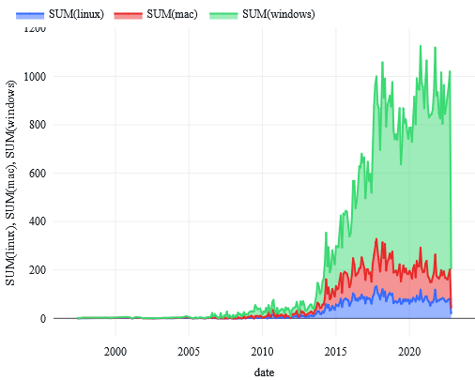
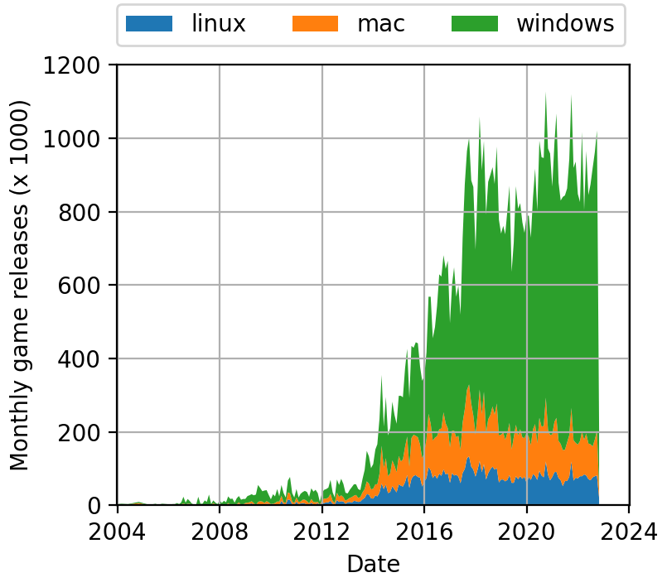
Data processing
Data loading in Spark
Data visualization
Direct download from AWS S3
Export to Python structures (pandas.DataFrame, np.ndarray, list) and build visualization (matplotlib, plotly, ...)
Download file locally (61Mb)
Use vizualization tools from cloud services (eg Databricks)
Data processing in PySpark
DataFrame API
Process with object methods
Databricks plotly figure
Matplotlib figure
SQL API
Process with SQL queries
Pandas API
Convert to pandas.DataFrame

Slide 7



Comparison of the technologies used
Python-like interface
Distributed computations
Engine agnostic
Compatible with many frameworks
Very flexible full Python expressivity
Flexible
Slow computation setup
Inefficient for small datasets
Non-distributed compute
Inefficient for large datasets
Distributed computations
Limited to a few langages
Java/Scala/Python/R
Not flexible
Difficult to carry complex data transformations
Requires Python

Slide 8
Comparison of the technologies used
Python-like interface
Distributed computations
Engine agnostic
Compatible with many frameworks
Very flexible full Python expressivity
Flexible
Slow computation setup
Inefficient for small datasets
Non-distributed compute
Inefficient for large datasets
Distributed computations
Limited to a few langages
Java/Scala/Python/R
Not flexible
Difficult to carry complex data transformations
Requires Python
Data processing strategy
Large-scale operations with PySpark
Small-scale processing with Python

Slide 9
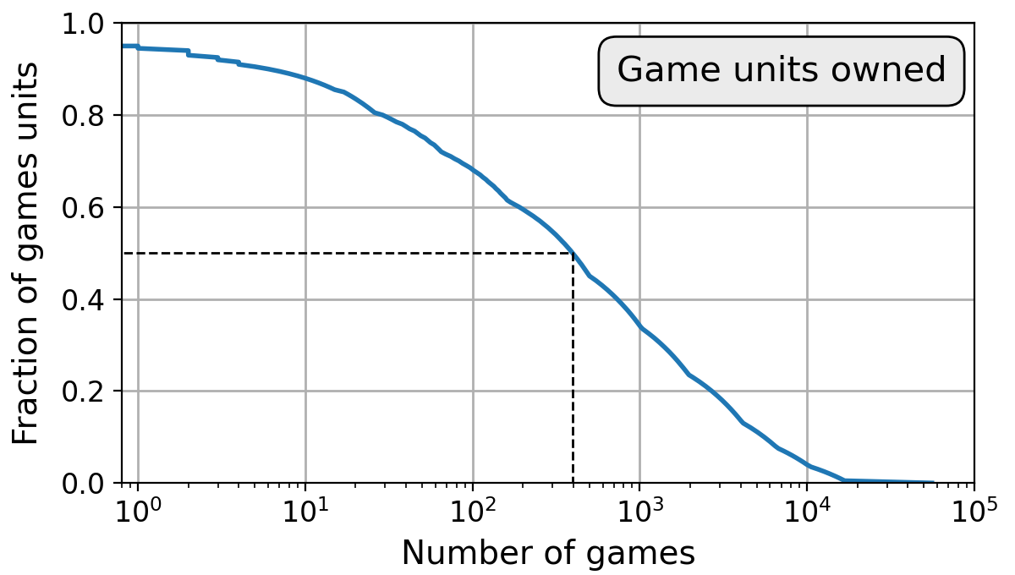
Key takeaways on the videogames market
Videogames market dominated by a few big companies
Half units distrubuted from 400 games

Slide 10
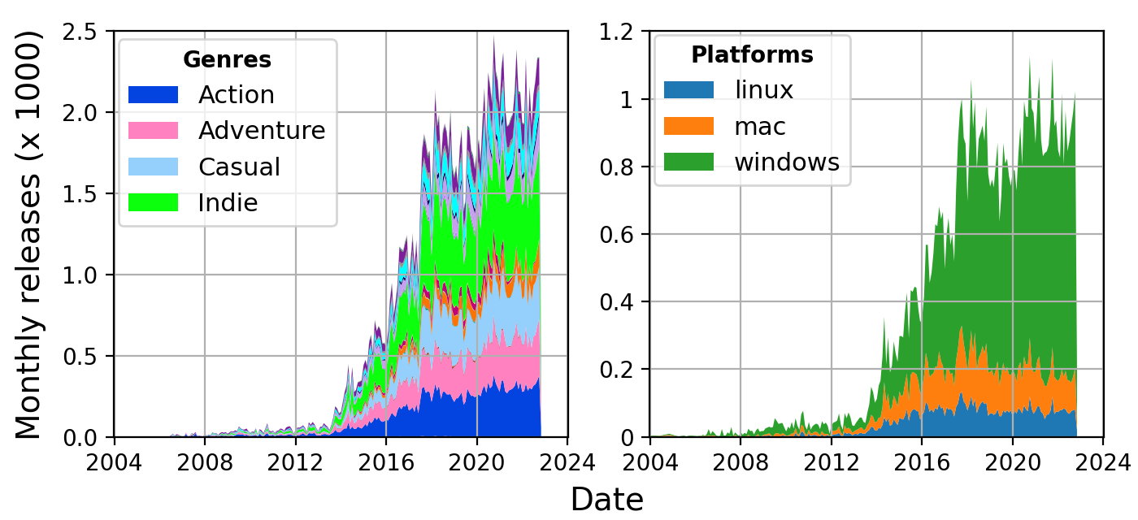
Key takeaways on the videogames market
Videogames market dominated by a few big companies
Half units distrubuted from 400 games
Game release increase until 2018 then stabilized
Windows is the dominant platform
Major game genres : action, adventure, causal and indie

Slide 11
Key takeaways on the videogames market
Videogames market dominated by a few big companies
Half units distrubuted from 400 games
Game release increase until 2018 then stabilized
Windows is the dominant platform
Major game genres : action, adventure, causal and indie
Microtransactions are an important source of revenue
Major free games : Dota 2, ...

Slide 12

Thanks!

